Slide 1
Teaching with Primary Sources
Building Resources for Success

Slide 2
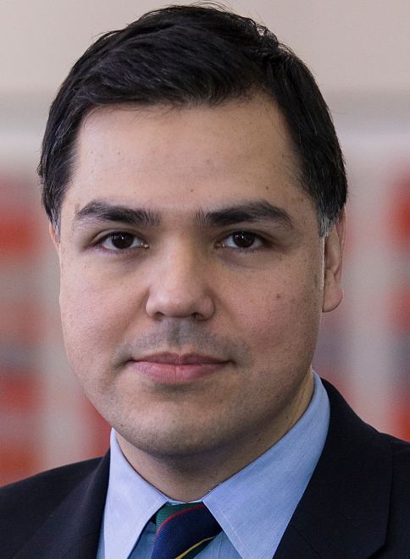
Project Team
Notes:
Project team expertise:
Fobazi Ettarh: resident librarian--a school media librarian with pedagogical training
Josue Hurtado: coordinator of outreach and public services
Kim Tully: curator of printed materials
Margery Sly: director

Slide 3
Opportunities
Eight months dedicated time to help grow SCRC’s instruction program
A staff member with pedagogical training
Value of non-archivist perspective
Exponential growth in resources and infrastructure
Notes:
Eight months of Fobazi’s dedicated time to help us to grow SCRC’s instruction program
Value of someone with pedagogical training
Value of non-archivist perspective
Exponential growth in structure and resources enabling us to grow our instruction program much more quickly than we could otherwise. Looking to 2019 when we move into our new building which has a dedicated classroom.

Slide 4
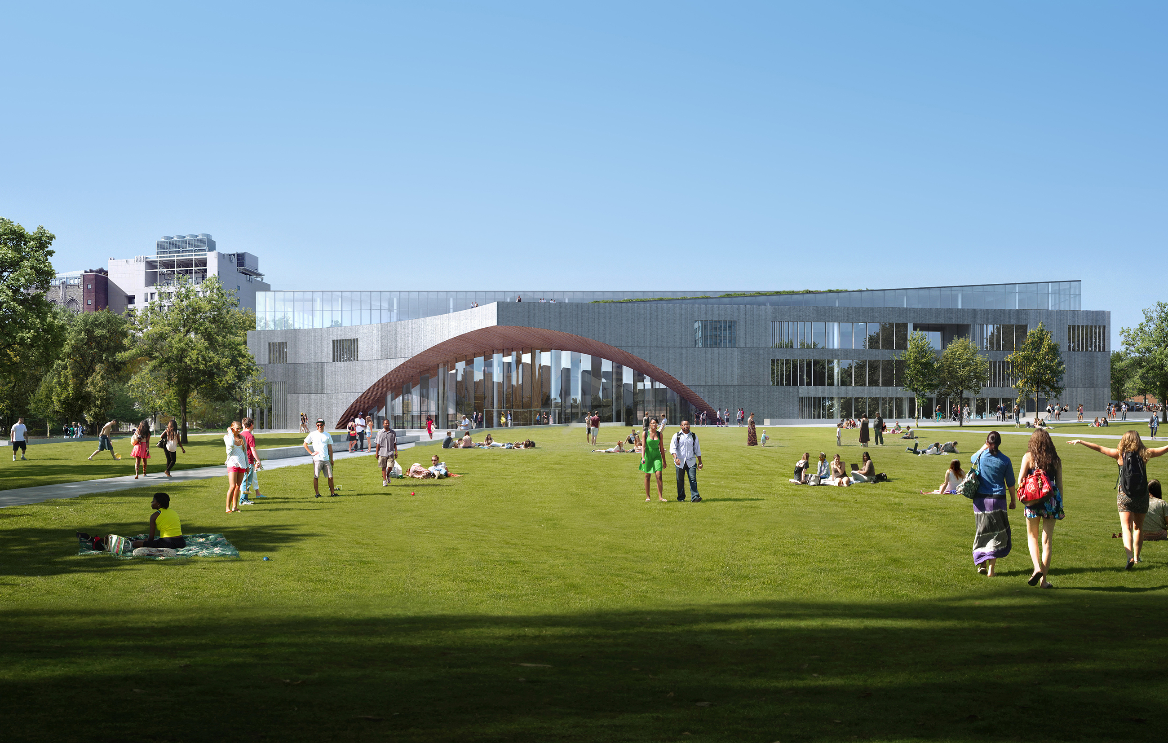

Slide 5
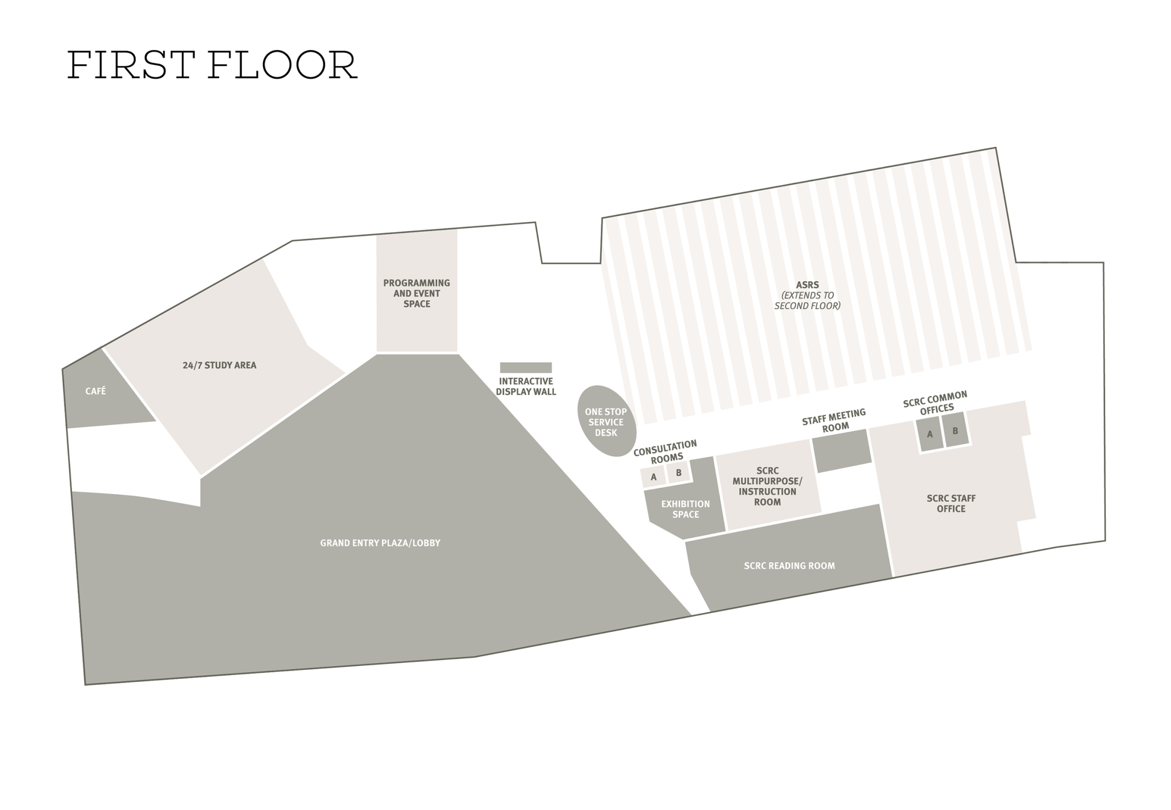
Notes:
Important both because we want to continue to grow our instruction program and because our new library building, opening in mid-2019, has a dedicated classroom which we want ot use effectivelyl.

Slide 6
PROcess
Literature Review
Research
Observation
Interviewed other archivists with successful programs
Attended MARAC

Slide 7
Products
Modules for instructional planning, design, delivery/communication, and assessment
Mission
Value of primary source literacy
Script
Glossary
Bibliography
Sample Lesson Plans
Historical Analysis and Skills Development matrix
Learning Outcomes
Notes:
Script: how to describe SCRC and various collecting emphases—and the core rules and reasons
Glossary: Definition of terms (entertaining) – for laypeople: provenance, cataloging records, finding aid, etc., etc.

Slide 8
Rubric for Assessing Instructional Sessions
Skills: Observation, interpretation/context, evaluation/critical thinking, Research skills
Levels: Emerging, Developing, Competency, Mastery

Slide 9
Taxonomy of instruction types
Orientation
Content based instruction
Research methods
Format/Process based instruction
Notes:
For our libanalytics system and other sorting purposes and still a work in progress
Looking for parallels with ARL:
Content based instruction; a group session focused on specific topic, collection, type of material
Format based instruction: specific formats and processes (zB—photographic processes; book structures; zines)
Orientation: hows and whys of preservation and security rules; services
Research Methods: how to research in primary sources—archival/primary source literacy
-----Types of Instruction with Definitions
Content Based Instruction- Scheduled group sessions with a class of students in which an SCRC staff member conducts a lesson focused on a specific topic or collection.
Research Methods- Scheduled group sessions with a class of students in which an SCRC staff member teaches primary source literacy, archival literacy, and/or archival research methods.
Materials Based Instruction/Orientation- Scheduled group sessions with a class of students in which an SCRC staff member conducts a lesson for the purpose of introducing and orienting students to services and resources within SCRC.
Process Based Instruction- Scheduled group sessions with a class of students in which an SCRC staff member conducts a lesson for the purpose of introducing students to specific archival formats and processes (e.g. AV materials).

Slide 10
Reading Group
monthly reading group of interesting staff to build
Build a community of practice
Training
Improve our teaching skills

Slide 11
Next Steps
More on assessment
Model lesson plans
Education for staff in pedagogical techniques
AND continue to do more instruction
Notes:
Challenge of assessment-- more
Use TU College of Ed as source of trainings.

Slide 12
Contact/questions
Special Collections Research Center
Temple University Libraries
Philadelphia, PA 19122
scrc@temple.edu

